Slide 1

How to track friends and meet interesting people
Mack Wilcox

Slide 2
Topics
Why
Morality / Legality
🍎 locationd
Wi-Fi Concepts
Execution Concepts
Demonstration
Virtual Concepts
Demonstration
Defend / Protect
Requirements
Python
C2 Channel
“Crowd Strike” for Blue
“Cobalt Strike” for Red
Low Code
No Registration

Slide 3
Additional Reading: https://www.maxmind.com/en/locate-my-ip-address
Why?
Why Not?
Litigation
Location Controls
Legal Implications
VIP Information
Spearphish / Demonstration
Other Products Lacked Fidelity
Alert Fatigue
VPN Locations
Asset Recovery
Creepin

Slide 4

Additional Reading: https://developer.apple.com/app-store/review/guidelines/#location
Morality / Legality
Emphasis
Don’t Be Evil
Don’t Be A 🍆 (D.B.A.D.)
Obtain Legal Authorization Prior
Interesting People May Include
Law Enforcement Officers
Angry Customers
Not A Lawyer
Not Legal Advice
Do Consult A Lawyer
I Have No Idea What I Am Doing

Slide 5
🍎 locationd
Accepts BSSID
Returns Location
Uses Protobuff Protocol For Communications
No Auth Required
No API Key Required
Additional Information (Not Used)
Elevation
Frequency

Slide 6
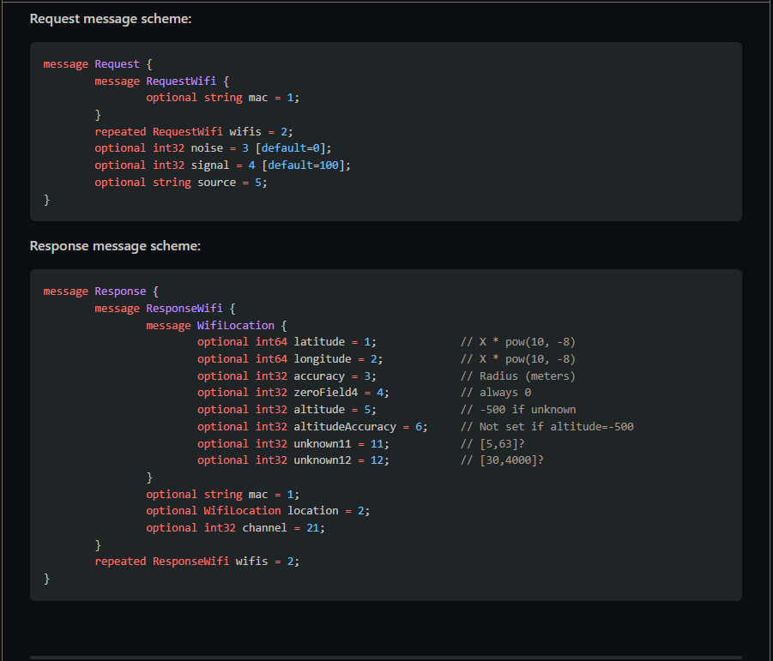

Ref & Credit@ https://github.com/zadewg/GS-LOC
🍎 locationd cont’d

Slide 7
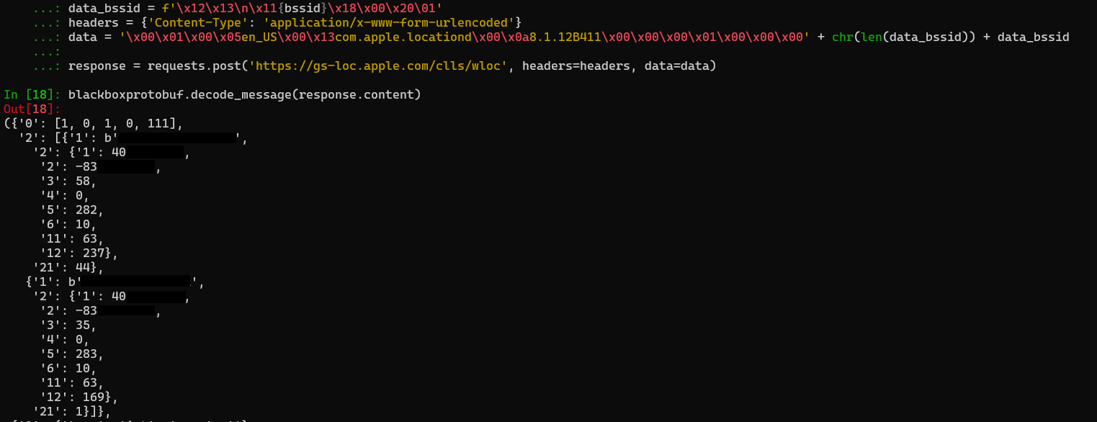
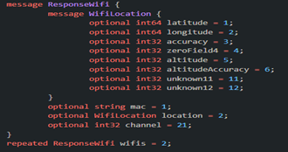
Ref & Additional code @ https://github.com/mwilco03/Fruiti-finder https://github.com/zadewg/GS-LOC
🍎 locationd cont’d
**:**:**:**:**:**
********
********
**:**:**:**:**:**
********
********

Slide 8

Ref & Additional commands @ https://github.com/mwilco03/Fruiti-finder/blob/main/Helpful.txt
Execution Concepts
The following commands will return BSSIDs
Cmd
PowerShell
Mac
Nix
C:\Users\Haxxor> netsh wlan show network mode=BSSID | findstr BSSID
PS C:\Users\Haxxor> Find-Module Get-WLANs|%{Install-Module $_ -scope CurrentUser}; Get-wlans
Haxxor@Mactop: /System/Library/PrivateFrameworks/Apple80211.framework/Versions/Current/Resources/airport -s
Haxxor@Nix: iwlist wlan0 scanning

Slide 9



Distant computer Scans area for BSSID
Execution Concepts
MySpectrumWiFi9c-2G
d5:1b:c0:64:37:b4
FBI-Van3
1d:5d:17:bf:88:5e
HP OfficeJet Pro 9010
dc:37:4b:33:24:0d

Slide 10


web request from the controlling computer obfuscates location observation
Execution Concepts
MySpectrumWiFi9c-2G
d5:1b:c0:64:37:b4
❌
FBI-Van3
1d:5d:17:bf:88:5e
C2 Channel
Web Request
✔️
HP OfficeJet Pro 9010
dc:37:4b:33:24:0d
locationd
❌
✔️ BSSID MAC found in DB
found 1d:5d:17:bf:88:5e at https://google.com/maps/dir/-180.0000,-180.0000

Slide 11
Pray For Me
Live Demo

Slide 12

So that happened…… So A new challenge appeared
Virtual Concept
The Following Conversation Occurred
“You Made The Thing That Tracks Endpoints” –Customer
“Yea, Through Wi-Fi ☺” –Me
“Cool, Can You Tell Me Where The Person Using This VM Is?” –Customer
“…Through…Wi-Fi…?” –Me
Long Confused Silence –Both

Slide 13
Additional Ref: https://github.com/browser-history/browser-history IE on roadmap Submitted PR 207
Virtual Concept
On Box Browser History
URL Traffic From Proxy Logs
Analysis Extremely Useful
Could Plausibly Be Presented As Evidence
Extreme Caution
City Level Fidelity
Tamper Prone
Best Use Cases
Litigation Area of Responsibility

Slide 14
Additional Ref: https://github.com/mwilco03/Fruiti-finder https://medium.com/dataseries/how-to-extract-google-maps-coordinates-8751a7389735
Virtual Concept
Google Maps
Lat & Lon Passed As Part Of Query String
Passes Multiple Pieces Of Data
Including Coords
Passed “!” Delim Format
maps/place/Space+Needle/@47.6205099,-122.3514661,
17z/data=!4m5!3m4!1s0x5490151f4ed5b7f9:0xdb2ba8689ed0920d!8m2!3d47.6205063!4d-122.3492774
Other Services / Non-Google
Potentially Other Non-Maps Endpoints
Login*

Slide 15
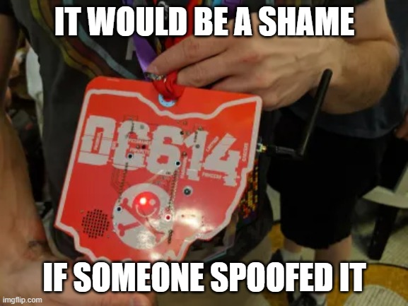
Additional Ref: https://github.com/dc614/DC-27-Badge
Combat
Attack The Attacker
That’s A Nice Network You Have There
Hard Line
Disable Wi-Fi
Tested On Windows
Reg Vals Doesn’t Take Affect Till Reboot
Clear Browser History

Slide 16
Open Discussion
Questions

Slide 17

Thank You
someone@example.com

